Slide 1

Bright Futures CLC

Slide 2
BFCLC Website Details
Home
About Us
Our Programs
Student Registration
Events
Photo Gallery
Human Resources/Volunteer
Contact Us

Slide 3
Home Page
Video of students, parents, and staff testimonials (uploaded}
Executive Director Letter (cont’d in pop up)
Ticker of current events and announcements (Scrolling across top of screen updated daily by staff)
~ There is a place in God's sun for the youth 'farthest down' who has the vision, the determination, and the courage to reach it ~ Mary McLeod Bethune
Notes:
(Letter from Director to be posted on Home page and cont’d on About us page
Inspiration. What does it mean in the life of a child? I believe it means us presenting young people, particularly those with limited choices, with life experiences, opportunities and skills that will leverage them into productive caring and responsible adults. Click here to continue reading

Slide 4
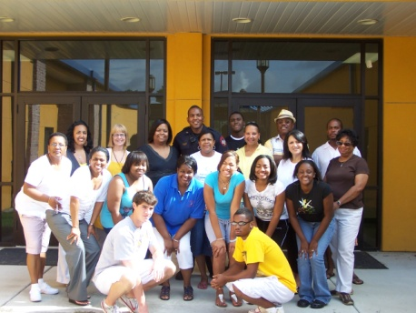
About Us
Staff Information (click on)
Program Overview
350 children served since our inception……
GENDER
55% male
45% female
AGES
10% under 9
12% 10-12
15% 13-15
ETHNICITY
90% African American
4% Caucasian
6% Hispanic
Mission Statement (click on)
ADULT STAFF & VOLUNTEERS
13 Certified Teachers
4 Professional Staff (Enrichment)
17 Teacher’s Aides
50 Program Volunteers
3 Bus Drivers
2 Custodians
13 Advisory Council Members
4 Administrative Staff persons
Notes:
Staff Information would list names (possibly pictures and brief statements from them about what they do at BLCLC and why they do it……
Director’s Letter Cont’d…
Over 2 years ago, we embarked on a journey to provide services to our young people. In the past 2 years, we’ve worked to establish a positive base from which to influence the disadvantaged youth of the City of Donaldsonville. The ultimate goal? To instill hope that will in turn change lives for the better.
We have high hopes for the difference we will continue to make in the lives of the young people. With that hope is the realization that there is a real crisis confronting young people across the country – high school drop out rates on the rise, teen pregnancy at near epidemic proportions, poverty domestic violence, childhood obesity, community blight in entire neighborhoods – These are very real issues here at home as well.
Imagine. With the support of our strong partners, parents, the school district, and community leaders; we have made a difference. Imagine the impact that summer camp has had on the 300+ young people that participated for six weeks for the past two summers and were exposed to activities they never imagined they would be interested in: classical ballet, golf, violin lessons, Spanish, art, sewing…Imagine the young men that learned the art of sewing in Life Skills class after school rather than hanging out on street corners prey for some drug dealer or other undesirable. Imagine the young girls that practiced classical ballet after school – rather than being a latch key who sits home with free time to land in trouble. Imagine the lives that are being changed everyday because the parents of these young people now have a choice.
It’s our goal to remain on the forefront of the issues that confront our young people and their families. This is just the beginning. Bright Futures will move forward with a bold vision and clear direction aimed at launching our young people into bright futures and model citizenship. At a time when unemployment is at an all time high, our program has afforded more than 50 employment opportunities in this city!
You, our strong partners have been instrumental in making this vision a reality. Thank you for your partnership, your interest and support as we continue to bring opportunities to the youth and families of the City of Donaldsonville.
~ There is a place in God's sun for the youth 'farthest down' who has the vision, the determination, and the courage to reach it ~ Mary McLeod Bethune
Donna Gaignard
Executive Director
Mission Statement
Our mission is to ensure bright futures for at risk children by providing them with educational opportunities and creating an atmosphere that promotes creativity and self-worth within them; to establish a strong presence in the community that will influence them to become viable caring and productive participants in mainstream society; to encourage college graduation. We pledge to promote the enrichment of the lives of people in this community by providing ways for them to be exposed to positive educational and creative opportunities that promote healthy living, successful academic prowess and cultural awareness. We believe that our future is directly bound to the future of our young people and we will provide supportive healthy environments to nurture their overall growth. ……Bright Futures CLC

Slide 5
Programs
Summer Camp (click on for description-separate pop up window)
After School Academic Enrichment
Arts (click on for description-separate pop up window)
Recreation (click on for description-separate pop up window)
Field Trips (click on for description-separate pop up window)
Notes:
Summer Camp Description:
Music Lessons
Life Skills
Fine Arts
Volleyball
Golf
Tennis
Drama
After School Enrichment Description:
BF offers help in Math and ELA as well as ……………..
Arts
Students receive music lessons, fine arts, arts & crafts, dance including salsa, hip hop and classical ballet
Recreation
SPARKS

Slide 6


Registration Page
Registration application (download in pdf or word) OR
Online registration form (click, complete and submit online)
Online payments ( Pay Pal – Encryption…)

Slide 7
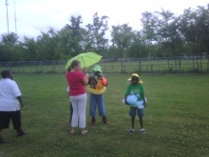

Events
              Water Safety Workshop July 25, 2011
              Smart Bodies Workshop August 4, 2011
Notes:
List current and upcoming events

Slide 8

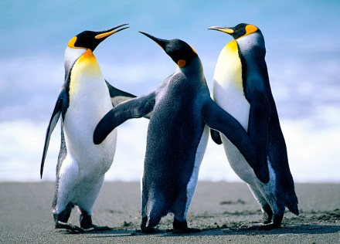

Photo Gallery
Pictures of past events by topic
Christmas Play 2010 Lion King Show July 2011 Michael Jackson July 2011

Slide 9


Human Resources
HR forms
  Employment Application (pdf or online submission)
    Contact Information (pdf)
  Federal Tax forms (Link to IRS site) http://www.irs.gov/businesses/small/article/0,,id=99194,00.html
  State Tax Forms (Link to Revenue Dept. site)
  http://revenue.louisiana.gov/forms/taxforms/1300T(10_08)f.pdf
  Volunteer

Slide 10
Contact Us
Contact information for the center.
Call us at 225 473 2002
Fax us at 225 473 6001
Email us at bfutures1@gmail.com
Visit us on Facebook
Comments:
Type your comments here

Slide 11
What students are saying…………
% of students in the summer program that reported : At least one adult here cares about me all the time - 82.9%
% of students that reported feeling welcome in the Program all the time – 86.8%
% of students that reported “I really like coming to this Program”, all the time – 67.2%
% of students that reported “the activities here are fun” all the time - 69.9%
% of students that reported “the activities here challenge me to learn new skills ” all the time - 65.2%
% of classes for which more than half of students reported liking a lot - 100%
% of students that reported liking Water Day a lot – 100%

Slide 12
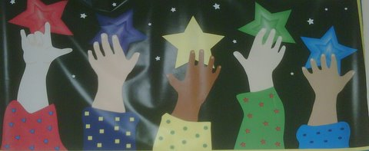
Reaching for the Stars!
~ There is a place in God's sun for the youth 'farthest down' who has the vision, the determination, and the courage to reach it ~ Mary McLeod Bethune

Slide 13
Donna Gaignard, Executive Director
Cell: (225) 717 2595
djgaignard@yahoo.com

