Slide 1
Building Blocks for Writing
Prof. Sarah Liggett
Communication across the Curriculum
enligg@lsu.edu

Slide 2
Rhetorical Triangle
Communicator(s)
Role
Relationship to audience
Knowledge of Subject
Audience
Roles—teacher, classmates
Knowledge of subject
Attitudes, values, feelings
Needs
Notes:
Finally, the rhetorical triangle which actually has four points and a rectangle, but let me explain . . . .
Go through diagram
Contexts for Communications: Disciplinary, Social, Political, Economic, Academic , Situational (deadlines, technologies, collaborations)

Slide 3
The Project
The goal of this project is develop a website for a non-profit organization, namely Bright Futures. The purpose of this website is to introduce visitors to who Bright Futures are and what they do. This is achieved by presenting information about activities and past events through pictures and reviews. Furthermore, we will try to implement an online registration system that will possibly replace existing hand written protocols.

Slide 4
Rhetorical Triangle
Communicator(s)
Project description,; organization, specified; style (standard edited English)
Text
Subject & Purpose
Audience
Familiar material or need for research
Inform, persuade, express
Roles—teacher, classmates
Knowledge of subject
Attitudes, values, feelings
Needs
Contexts for Communications: disciplinary, social, political, economic, academic, situational
academic, time constraints, funding limits, feasibility
Notes:
Finally, the rhetorical triangle which actually has four points and a rectangle, but let me explain . . . .
Go through diagram
Contexts for Communications: Disciplinary, Social, Political, Economic, Academic , Situational (deadlines, technologies, collaborations)

Slide 5
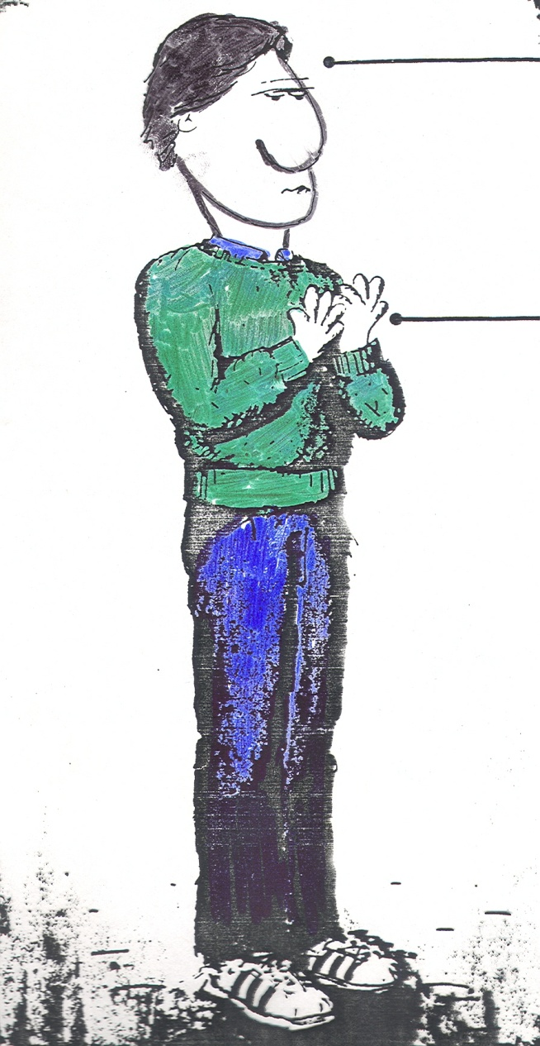
Critical Thinking
Writing starts here.
Not here.

Slide 6
Bloom’s Taxonomy
Evaluation
Making decisions and supporting views; requires understanding of values.
Combining information to form a unique product; requires creativity and originality.
Synthesis
Identifying context, components; determining arrangement, logic, content, style.
Analysis
Using information to solve problems; transferring abstract or theoretical ideas to practical situations. Identifying connections and relationships and how they apply.
Application
Restating in your own words; paraphrasing, summarizing, translating.
Comprehension
Memorizing verbatim information. Able to remember, but not necessarily fully understand the material.
Knowledge
This pyramid depicts the different levels of thinking we use when learning. Each level builds on the foundation that precedes it. We need to develop lower levels skills before we can effectively develop higher level skills.

Slide 7
Priorities in Writing
Initial concerns
  Audience
  Purpose
  Organization
  Content/Development
Later concerns
  Style
  Sentence structure
  Word choice
  Usage
  Mechanics

Slide 8
Project Description Components
Title
Project overview
Problem
Impact
Motivation/Inspiration

Slide 9
Title:
Make a clear first impression
Be informative
Include subject and purpose
Keep it short or use a subtitle
No punctuation at the end

Slide 10
Critique these titles
Epicenter Communiqué for Families Helping Disabilities
Iberville Arc Employee Scheduling Systems
Bright Futures: Online Presence and Convenience
Support Training—Providing Support for those in Need
BRBA Teen Court Database

Slide 11
Choose a title for a project to build a website for and African American museum
African American History—not just February but All year round.
African American History-All year round.
Then and now African American history.
African American history now and then.

Slide 12
Project Overview:
Sketch a clear picture
Clarify the end product (website, scheduling system, etc.)
Clarify purpose or goals for a successful project
Be specific

Slide 13
BE SPECIFIC.
Generalization is death to good writing.

Slide 14
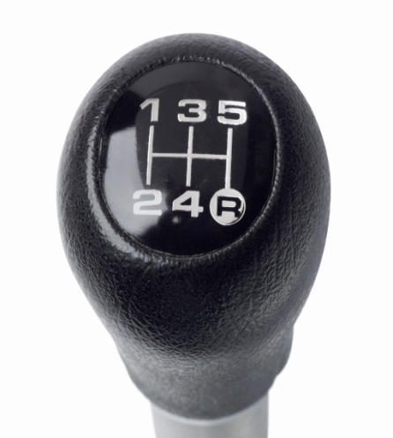
Downshifting
Move down the ladder of language abstraction
Shift from general to specific ideas to develop effective paragraphs.

Slide 15
Levels of Downshifting
Level 1: The topic sentence or generalization about the main point of your paragraph
Level 2: Explanation or qualification of Level 1
Level 3: General example of the topic being discussed.
Level 4: A specific example, perhaps an anecdote, a statistic gathered from research, dialogue

Slide 16
Basic principles of developing body paragraphs
Develop body paragraphs by adding sentences at a lower level of generality.
Remember: Well-developed body paragraphs usually have several levels of generality; that is, they shift more than once.
Add both interest and evidence through down shifting.
Use good, supportive evidence such as definitions of unfamiliar terms, examples and research to illustrate your point.
Check each body paragraph for a specific focus and purpose.

Slide 17
Downshifting: Examples in Context
Relative Treatment Effects of Two Prelinguistic Communication Interventions on Language Development in Toddlers With Developmental Delays Vary by Maternal Characteristics
sample paragraph

Slide 18
Project overviews for discussion
The goal of this project is develop a website for a non-profit organization, namely Bright Futures. The purpose of this website is to introduce visitors to who Bright Futures are and what they do. This is achieved by presenting information about activities and past events through pictures and reviews. Furthermore, we will try to implement an online registration system that will possibly replace existing hand written protocols.

Slide 19
Project overviews for discussion
The Iberville Arc Employee Scheduling System (IAESS) allows supervisors and administrators to schedule employees remotely through a web application. Supervisors and administrators can schedule, verify hours, check work history, and generate reports by applying features of IAESS.

Slide 20
Project overviews for discussion
This project is a website that will assist in the effort to share contributions made by African-Americans to the fabric of our society.
Create a few websites that display sustainability at Louisiana State University. The project consists of a sustainability map, green courses, green measurement, and the UNPLUGG competition complete with an “energy dashboard” to show energy conservation progress around campus.

Slide 21
Statement of the Problem
Create a clear picture of the problem and its consequences
Contrast the actual with the ideal
  X is the current situation and consequently . . .
  Y is the way it should be
  Therefore, in this project

Slide 22
Problem Statement for Review
The current staff is already shorthanded and overworked. It takes time out of their busy schedule to provide these training courses and quizzes. An online training module would help to alleviate the time and work constraints associated with having a worker administer the training and testing personally.

Slide 23
Problem Statement for Review
When storing, accessing and modifying a large amount of information it becomes increasingly difficult to organize it in an understandable form. The current way of storing information in a Microsoft Excel spreadsheet is inefficient and cluttered. This database is intended to alleviate these problems by implementing efficient structure and design.

Slide 24
Guidelines for Designing Segments: Impact and Motivation
Segments of a report should
  stand alone (self-sufficient, selectively redundant)
  have a beginning, middle, and end
  have a clear purpose and focus

Slide 25
USE WRITING RESOURCES WISELY
Purdue's on-line writing lab (OWL)
UNC Writing Center
Studio 151--Writing Resources

