Slide 1



The Impact of Soft Resource Allocation on n-tier Application Scalability
Qingyang Wang, Simon Malkowski, Yasuhiko Kanemasa, Deepal Jayasinghe, Pengcheng Xiong, Motoyuki Kawaba, Lilian Harada, Calton Pu
Notes:
Collaborative work between Georgia Tech and Fujitsu lab

Slide 2
Outline
Background & Motivation
  Background
  Motivational experiment
Performance Impact of Soft Resource Allocation
  Over-allocation of soft resources
  Under-allocation of soft resources
  Special case of under-allocation
Solution
  A practical algorithm for good soft resource allocation
Conclusion & Future Works

Slide 3


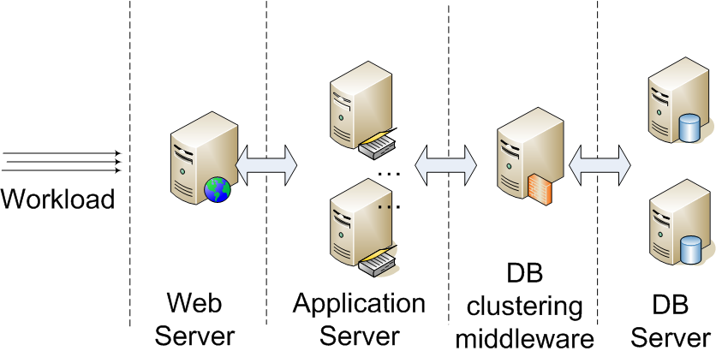

Cloud Computing Environment
Good performance + Cost efficiency
High throughput + low response time
High resource utilization
Scaling applications on demand
Notes:
Nowadays many web applications use n-tier architecture as show in this picture.
Usually they have web servers in front, application servers and database servers at the backend. They may also have cluster middlewares for load-balancing.
Such applications are especially beneficial to deployed in cloud environments because we want to achieve both good performance and cost efficiency.
#### (Yasu’s comment)
Change “CJDBC Server” to “DB clustering middleware”.

Slide 4


Soft Resource Allocation
Is it okay to duplicate the same configuration of soft resource allocation?
Soft resources in n-tier systems
  Threads, database connections, TCP connections, locks, etc.
Notes:
However, scaling an n-tier system is not as simple as adding more servers into the bottleneck tier, there are many hidden resources which are not shown in this pictures, for example, soft resources in n-tier systems. soft resources we mean are threads, database connections. Such soft resources are also critical to system performance as we will show in the following slides.
#### (Yasu’s comment)
Change “CJDBC Server” to “DB clustering middleware”.
Change “Is it okay to duplicate the same configuration of soft resource allocation?” to a sophisticated sentence.

Slide 5
Outline
Background & Motivation
  Background
  Motivational experiment
Performance Impact of Soft Resource Allocation
  Over-allocation of soft resources
  Under-allocation of soft resources
  Special case of under-allocation
Solution
  A practical algorithm for good soft resource allocation
Conclusion & Future Works

Slide 6

Experimental Environment (1)
RUBBoS benchmark
  Bulletin board system like Slashdot (www.slashdot.org)
  Typical 3-tier or 4-tier architecture
  Two types of workload
    Browsing only
    Read/Write mix
  24 web interactions
C-JDBC
  Middleware for database scale-out
    Read: act as a load-balancer
    Write: send a request to all databases to keep consistency

Slide 7
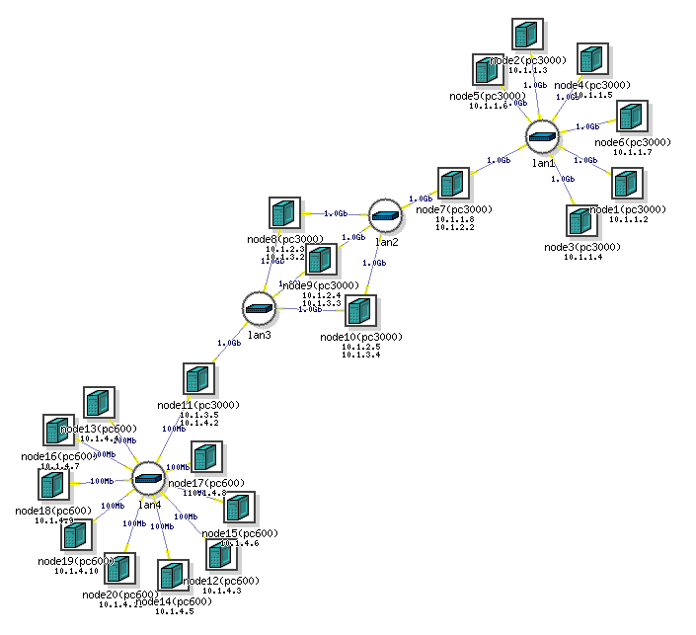
Experimental Environment (2)
Emulab (http://www.emulab.net)
  Relatively modest testbed originally for network research
  Virtual network & physical machines (not VM)
Hardware | Specifications
Server type | PC3000 in Emulab
Processor | Xeon 3GHz 64bit
Memory | 2GB
Network | 1Gbps
Disk | 2 x 146GB 10,000rpm
Notes:
#### (Yasu’s comment)
In the table, are “Hardware” and “Components” proper words?

Slide 8
Experimental Environment (3)
Software setups
Function | Software
Web server | Apache 2.0.54
Application server | Apache Tomcat 5.5.17
DB clustering middleware | C-JDBC 2.0.2
Database server | MySQL 5.0.51a
Java | Sun jdk1.6.0_14
Operating system | Redhat FC4
System Monitor | Sysstat 7.0.2

Slide 9
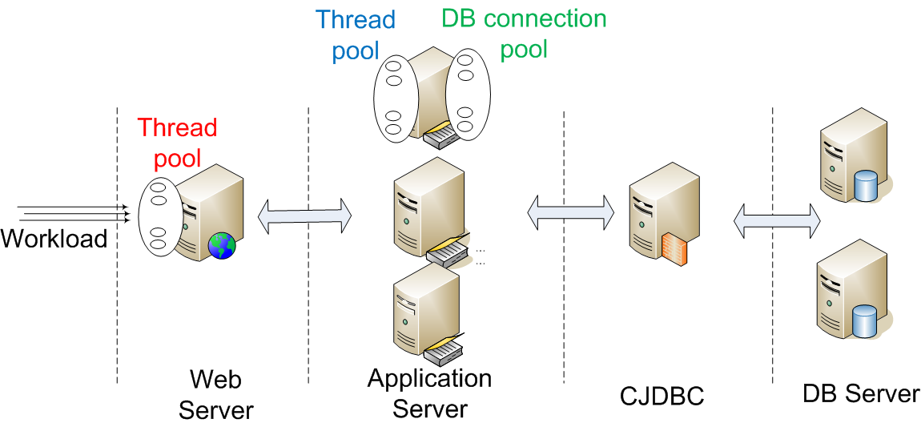
Experimental Environment (4)
Notation
1 / 3 / 1 / 2 configuration
400-6-200
Notes:
#### (Yasu’s comment)
Change this example to “1/2/1/3” or “1/3/1/2”.

Slide 10
Result of Motivational Experiment
Scale out

Slide 11
Challenge
How to choose a reasonable soft resource allocation to match the hardware configuration?
Good performance
Soft resource allocation 1
Hardware configuration 1
Thread pool,
DB connection pool
Bad performance
Scale out
Hardware configuration 2
Soft resource allocation 2
Thread pool,
DB connection pool
Good performance
Hardware configuration
Soft resource allocation
Notes:
The problem I just introduced can be abstracted as shown in this figure. Under a specific workload, a hardware configuration has to match the above soft resource allocation to achieve good performance. When the hardware scales up and the soft resource allocation still keeps the same, the system may get bad performance; in order to get good performance, we also need to adjust the soft resource allocation to match the new hardware configuration. There are two challenges:
How does soft resource impact system performance.
How to choose a reasonable soft resource allocation to match the underlying hardware configuration.

Slide 12
Focus of This Paper
Evaluate two important soft resources
    Threads
    Database connections
Show their performance impact on n-tier applications
    Over-allocation & under-allocation cases
    Special case of under-allocation
Introduce a practical way to choose a reasonable allocation of soft resources

Slide 13
Outline
Background & Motivation
  Background
  Motivational experiment
Performance Impact of Soft Resource Allocation
  Over-allocation of soft resources
  Under-allocation of soft resources
  Special case of under-allocation
Solution
  A practical algorithm for good soft resource allocation
Conclusion & Future Works

Slide 14
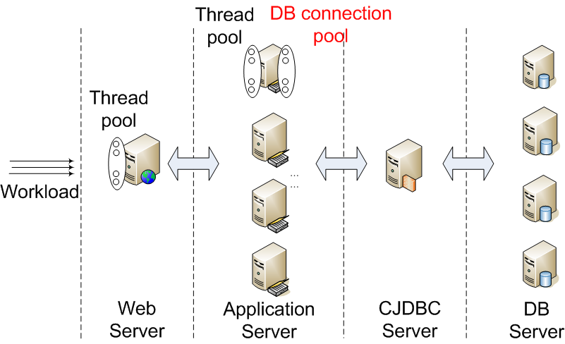
Performance Loss due to Soft Resource Over-allocation (1)
400-200-6
Sensitivity analysis: change DB Connection pool size in Tomcat

Slide 15
Performance Loss due to Soft Resource Over-allocation (2)
Goodput 1/4/1/4
CPU utilization in CJDBC
200
6
6
50
Performance degradation
Throughput with response time boundary
100
200
High allocation of DB connections in Tomcat degrades the system performance
Notes:
The graph on the left show the system goodput as workload increase. Goodput in fact is the throughput with response time boundary. For example, we only counts the requests with response time less than two seconds as throughput. Goodput can be considered as the SLA throughput. Higher goodput means better system performance.
In this set of experiments we change the number of DB connections from 6 to 200. We can see that the higher DB connections we allocate to Tomcat, the worse performance the system can get.
The graph on the right show the CPU utilization of the CJDBC server in the system. This graph shows the CPU of CJDBC starts to saturate as workload increases, which means the CJDBC CPU is the bottleneck resource in the system. The interesting point here is the 6 DB connection cases as shown in the red line. The CJDBC consumes the least CPU in 6 DB connection case but achieves the highest goodput in the system. The questions is why the CJDBC consume less CPU but achieves higher goodput?

Slide 16
JVM Garbage Collection Costs
JVM Garbage Collection in CJDBC
200
8% more time used for GC over experimental time
6
Over-allocation of soft resources causes waste of critical hardware resources
Notes:
As we found out JVM garbage collection in the CJDBC server played a major role degrading the system performance. The x axis of this graph shows the workload and Y axis shows the percentage of JVM garbage collection time in the CJDBC server during a 12-minute experiment running time.
We can see that the CJDBC server spent more than 8% more time to do JVM GC than that of 6 DB connection case. The JVM GC impacts the system performance in two aspects, First, JVM GC freezes the entire JVM, which delayed the request processing in the CJDBC server. Second, during the JVM GC time, the CPU is wasted to clean the garbage in the memory, instead of processing requests in the CJDBC. Therefore, the longer the JVM GC period, the worse performance the system has.
This set of experiments shows that Over-allocation of soft resources wastes critical hardware resource.

Slide 17
Outline
Background & Motivation
  Background
  Motivational experiment
Performance Impact of Soft Resource Allocation
  Over-allocation of soft resources
  Under-allocation of soft resources
  Special case of under-allocation
Solution
  A practical algorithm for good soft resource allocation
Conclusion & Future Works

Slide 18
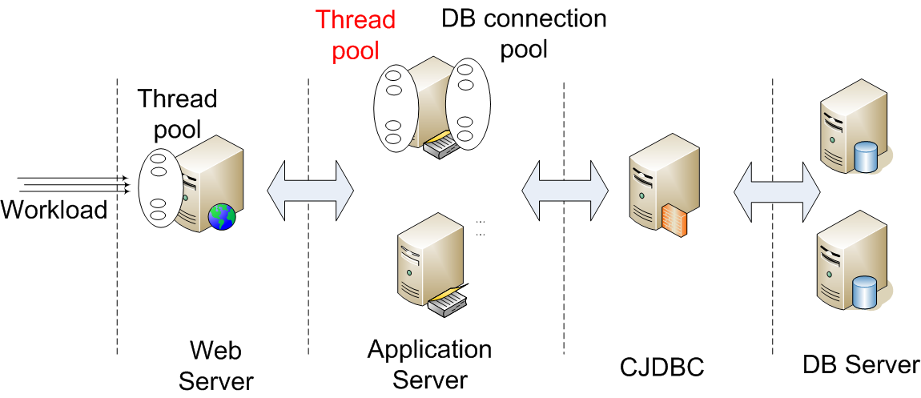
Performance Loss due to Soft Resource Under-allocation (1)
400-6-200
Sensitivity analysis: change thread pool size in Tomcat

Slide 19
Performance Loss due to Soft Resource Under-allocation (2)
Goodput 1/2/1/2
CPU utilization of Tomcat
20
20
200
10
6
6
Under-allocation of soft resources causes inefficient utilization of hardware resources
Notes:
The graph on the left shows the system goodput as workload increases. We change the number of thread in Tomcat server from 6 to 200 and we can see that the more threads in Tomcat server, the better performance the system can achieve. There is one exception here, the 200 case performs a little bit worse than the 20 case, which can be explained as over-allocation of soft resources in the previous case.
The graph on the right shows the CPU utilization of Tomcat. We can see that the Tomcat CPU starts to saturate as workload increases in the 200 case, which means the Tomcat CPU is the critical hardware resource in the system. However, if we only allocate the 6 threads in Tomcat, the average CPU utilization is just about 80%, far from saturation. This means the 6 threads in Tomcat is not enough to saturation the Tomcat CPU.
This set of experiments shows that under-allocation of soft resources cannot utilize the critical hardware resources efficiently.

Slide 20
Outline
Background & Motivation
  Background
  Motivational experiment
Performance Impact of Soft Resource Allocation
  Over-allocation of soft resources
  Under-allocation of soft resources
  Special case of under-allocation
Solution
  A practical algorithm for good soft resource allocation
Conclusion & Future Works

Slide 21
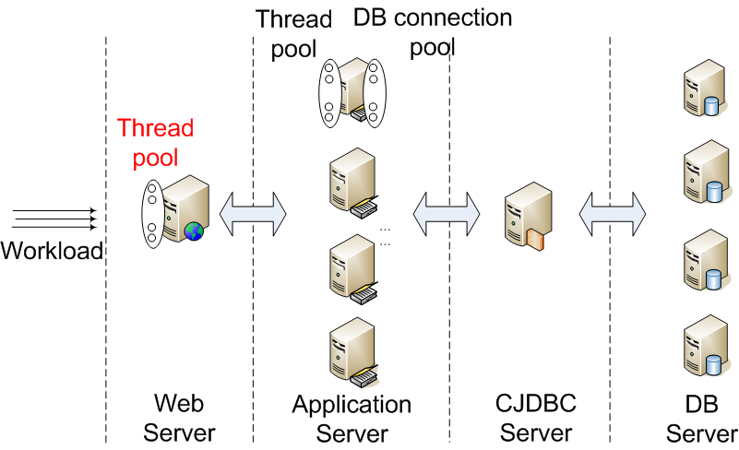
Special Case of Soft Resource Under-allocation
30-6-100
Sensitivity analysis: change thread pool size in Apache

Slide 22
Performance Loss due to Under-allocation of Apache Threads
Goodput 1/4/1/4
CPU utilization in CJDBC
400-6-100
400-6-100
100-6-100
50-6-100
30-6-100
30-6-100
Low allocation of Apache threads degrades
the system performance

Slide 23
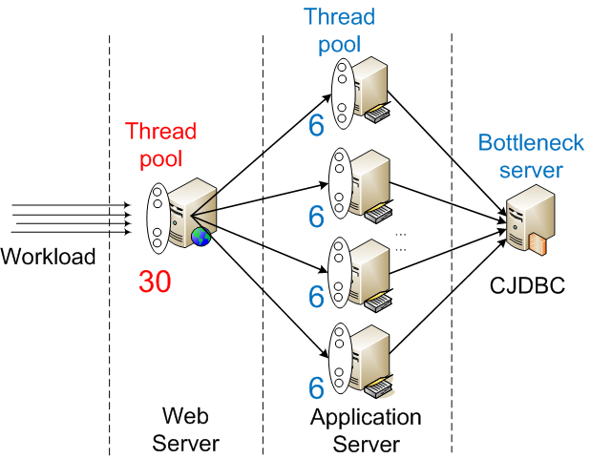
Non-Trivial Correlation between Apache and Tomcat Threads (1)
30-6-100
30 > 6 * 4
Why are 30 threads in Apache not enough?

Slide 24
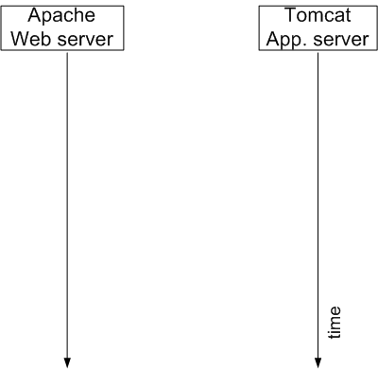
Non-Trivial Correlation between Apache and Tomcat Threads (2)
Waiting for TCP FIN reply from the client
Notes:
This graphs shows an example of interaction between an Apache thread and a Tomcat thread. First the apache thread receives a HTTP request, does some preprocessing and intact with Tomcat and receives response from Tomcat and do some post processing of the request and send a response to the client and waits for FIN reply from the Client.
We can see that during the entire active period of an Apache thread, only a part of it is used to communicate with Tomcat.

Slide 25
Non-Trivial Correlation between Apache and Tomcat Threads (3)
Waiting for TCP FIN reply from client
The long waiting time for FIN reply from clients is unpredictable and frequently happens under high workload
Notes:
This graphs shows an example of interaction between an Apache thread and a Tomcat thread. First the apache thread receives a HTTP request, does some preprocessing and intact with Tomcat and receives response from Tomcat and do some post processing of the request and send a response to the client and waits for FIN reply from the Client.
We can see that during the entire active period of an Apache thread, only a part of it is used to communicate with Tomcat.

Slide 26
Concurrency of Apache Threads
Concurrency for 30-6-100
Concurrency for 400-6-100
Connecting to Tomcat
Large number of soft resources in front tier acts as a buffer providing stable workload for lower tiers

Slide 27
Summary of Experiments
Over-allocation of soft resources causes waste of critical hardware resources
Under-allocation of soft resources causes inefficient utilization of hardware resources
Large number of soft resources in front tier acts as a buffer providing stable workload for downstream tiers

Slide 28
Outline
Background & Motivation
  Background
  Motivational experiment
Performance Impact of Soft Resource Allocation
  Over-allocation of soft resources
  Under-allocation of soft resources
  Special case of under-allocation
Solution
  A practical algorithm for good soft resource allocation
Conclusion & Future Works

Slide 29
Soft Resource Allocation Algorithm
  Key idea: allocating soft resources globally to utilize the critical hardware resource as efficiently as possible
Notes:
The third step, visit ratio

Slide 30
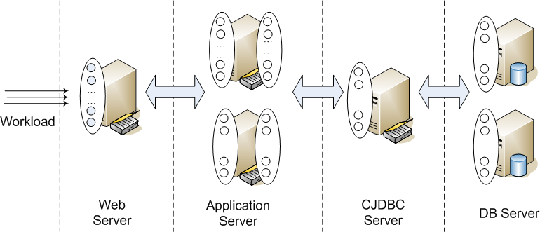
Soft Resource Allocation Algorithm (1)
  Identifying the critical hardware resource first
(1) Bottleneck server
Notes:
The third step, visit ratio

Slide 31

Soft Resource Allocation Algorithm (2)
  Identifying the critical hardware resource first
  Allocating proper soft resources for the bottleneck server
(1) Bottleneck server
Throughput knee
Minimum Saturation workload
(2) Ave. number of active threads
Notes:
The third step, visit ratio

Slide 32
Soft Resource Allocation Algorithm (3)
  Identifying the critical hardware resource first
  Allocating proper soft resources for the bottleneck server
  Allocating proper amount soft resources in other tiers
(3) Dependency between current tier and bottleneck tier
(1) Bottleneck server
(2) Ave. number of active threads
Notes:
The third step, visit ratio

Slide 33
Outline
Background & Motivation
  Background
  Motivational experiment
Performance Impact of Soft Resource Allocation
  Over-allocation of soft resources
  Under-allocation of soft resources
  Special case of under-allocation
Solution
  A practical algorithm for good soft resource allocation
Conclusion & Future Works

Slide 34
Conclusion
Achieving good performance by scaling n-tier applications in Cloud requires a unified exploration of both hardware and software
Contributions:
We showed allocation of soft resources has a big impact on the total performance of an N-tier system
We showed to decide a proper soft-resources allocation is a complex problem, especially in cloud environments which requires dynamic scaling-out/in
We gave a practical algorithm for proper soft resource allocation

Slide 35
Future Work
Explore more soft resources such as locks, buffer/queue
Explore more efficient ways to find proper soft resource allocation
Explore the impact of soft resource allocation in virtualized environment

Slide 36
Thank You. Any Questions?
Qingyang Wang
qywang@cc.gatech.edu

